Slide 1
A lower radius for the transiting extrasolar planet HAT-P-8
Signs of planetary formation & evolution 9 October 2012
Simona Ciceri
L. Mancini, Th. Henning, J. Southworth, J. Dittman,
J. Tregloan-Reed, I. Bruni, M. Barbieri, D. Evans, N. Nikolay

Slide 2
Outlines
The planetary system HAT-P-8
Observations & data reduction
Data analysis
Results
AIM
Obtain precise estimates of the physical properties of HAT-P-8
Signs of planetary formation & evolution 9 October 2012

Slide 3
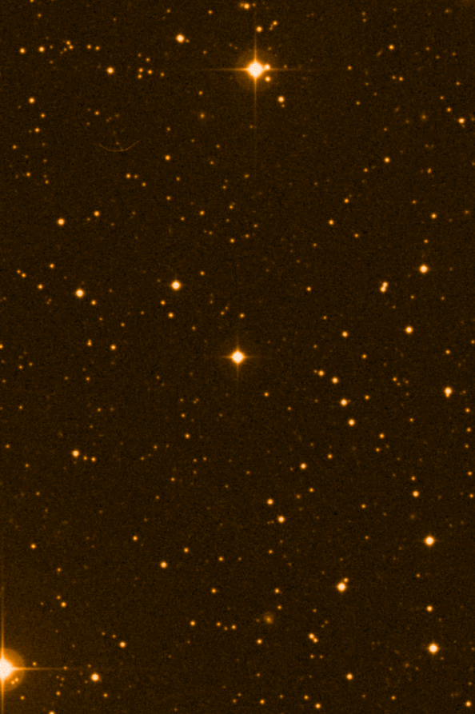
HAT – P – 8
Planetary system
Star
F8V Jones &Sleep 2000
F5V Bergfors et al. 2012
Hot Jupiter P = 3.076 d
Discovered by HAT Net (Latham et al. 2009)
Planet prograde
Moutou et al. 2011
Simpson et al. 2011
Signs of planetary formation & evolution 9 October 2012

Slide 4
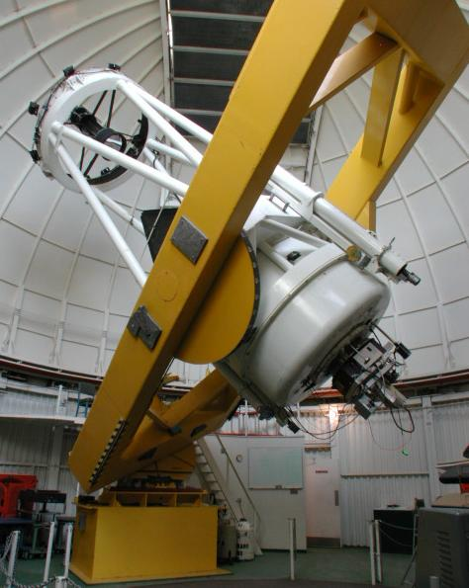
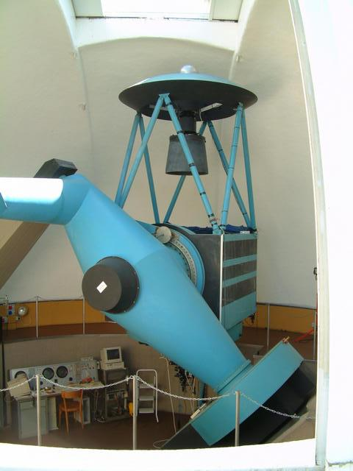
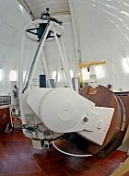
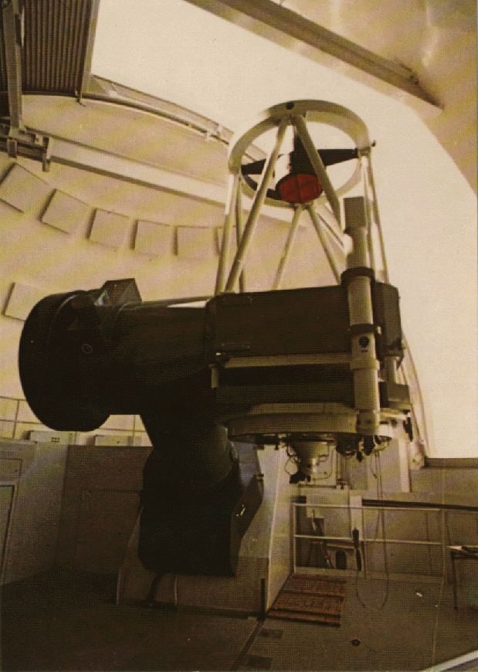
Observations & data Reduction
Kuiper 1.55m
Cassini 1.52m
INT 2.5m
Telescope defocussed
Images reduction
Bias-subtracted and flat-filded
Aperture photometry
CAHA 1.23m
Signs of planetary formation & evolution 9 October 2012

Slide 5
Analysis
Fit the light-curves looking for photometric quantities
JKTEBOP
Homogeneous Study project
Southworth 2008
Fit’s parameters:
Photometric parameters
Signs of planetary formation & evolution 9 October 2012

Slide 6
O - C
Data-sets from literature and amateur astronomer (ETD catalog)
Fit with JKTEBOB to find T₀
Linear fit of theT₀(FITEXY)
Looking for periodic variation in O-C
Signs of planetary formation & evolution 9 October 2012

Slide 7
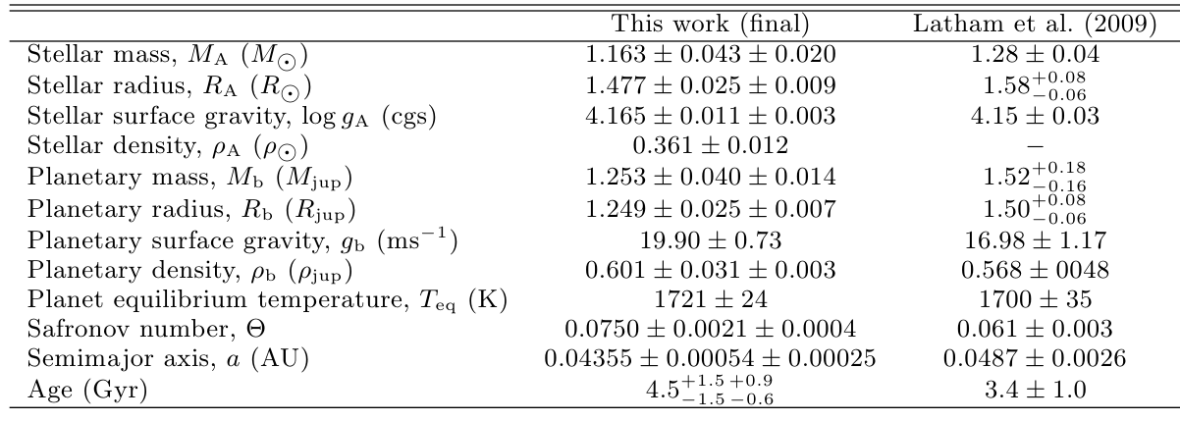
Results
Physical properties
Photometric parameters just found
stellar properties from -> published spectroscopic data
Latham et al. 2009 and Knutson et al. 2010
Interpolation of the parameters using different stellar models
Lower values for the radii
Values in a populated region of the R vs M diagram
Signs of planetary formation & evolution 9 October 2012

Slide 8
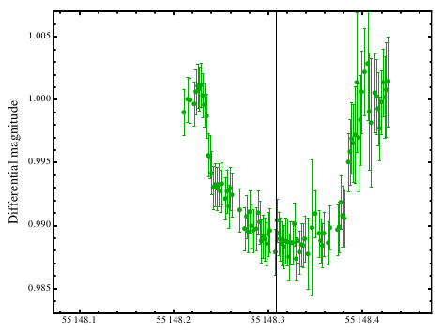
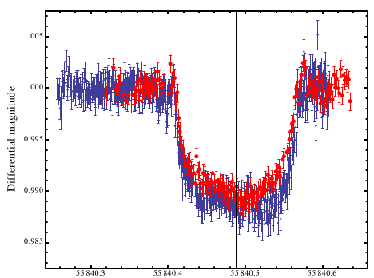
Interesting feature
12 - 11 - 2009
5 - 10 - 2011
BJD(TDB)- 2400000
BJD(TDB)- 2400000
Possible causes
Instrumental systematic
Exomoon
Faint flare star companion (Bergfors et al. 2012)
Belt of star-spots
-> different telescope and days
-> unlikely - not enough data
-> too faint - need of super flare
Signs of planetary formation & evolution 9 October 2012

Slide 9
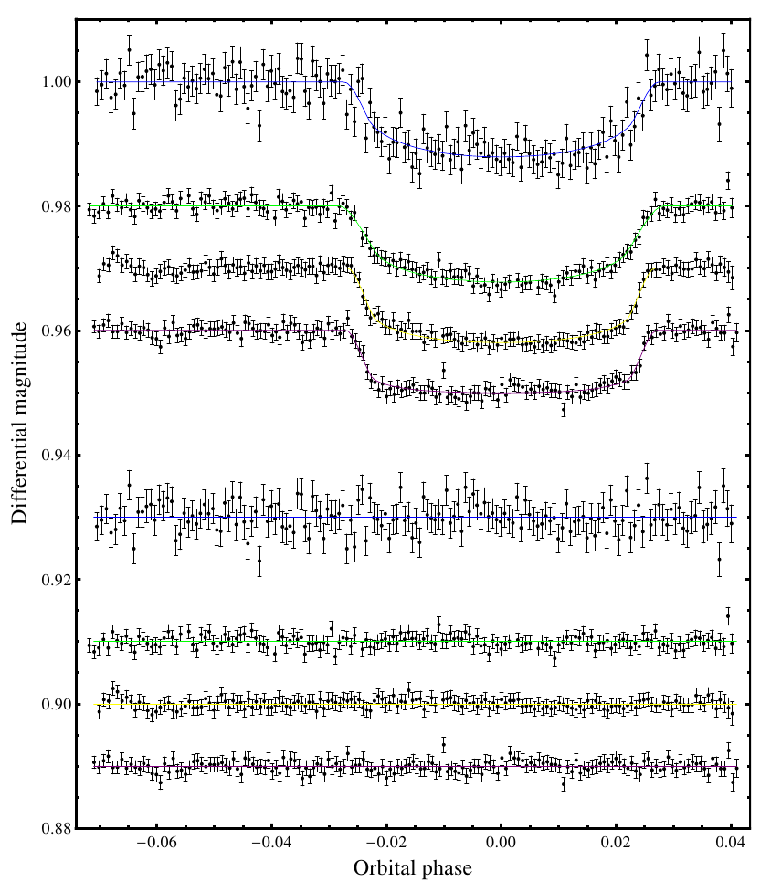
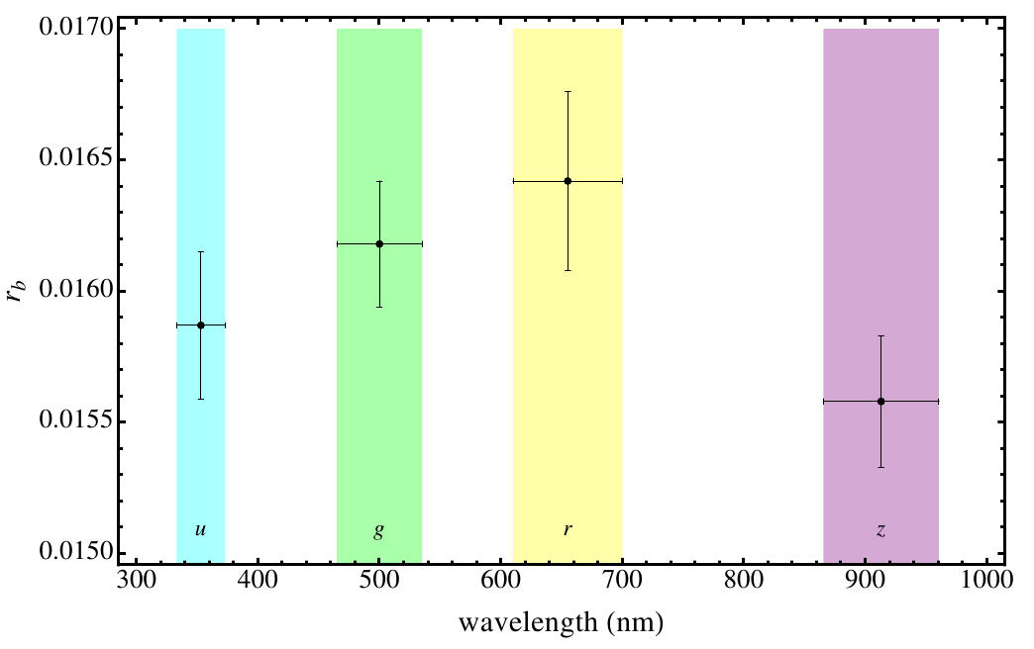
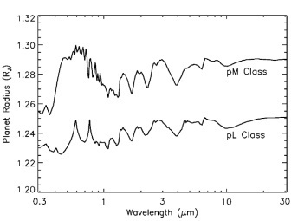
New observations
4 light curves of the same transit
BUSCA : 4 different filters
No strange feature
Looking for radius-wavelength dependence
Signs of planetary formation & evolution 9 October 2012

Slide 10
Summary
Five transit light-curves -> photometric parameters
Add spectroscopic data -> physical properties
→ lower value for Mb Rb
Mancini et al. 2012, A&A submitted
No clues of additional bodies from the O – C plot
Multi-wavelength transit light-curves (under analysis)
Signs of planetary formation & evolution 9 October 2012

Slide 11
Thank you for listening
Signs of planetary formation & evolution 9 October 2012

Slide 12
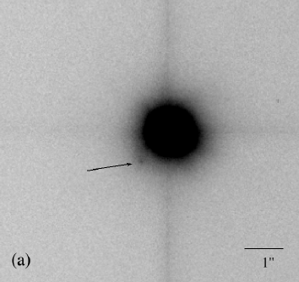
HAT – P – 8
Two-colors lucky imaging observations with the AstraLuxNorte instrument at the Calar Alto 2.2m telescope, revealed a i = 17.2-17.3 mag stellar companion, with an angular separation from HAT-P-8 of 1.027 arcsec.
This companion should likely be a M2-M4 background star, and since is only producing about 0.1% of the total light in i band coming from HAT-P-8, its presence do not affect any photometric study of this object.
(Bergfors et al. 2012)
Signs of planetary formation & evolution 9 October 2012

Slide 13
Wavelength – Radius variation
Fortney et al. 2008
Signs of planetary formation & evolution 9 October 2012

