Slide 1
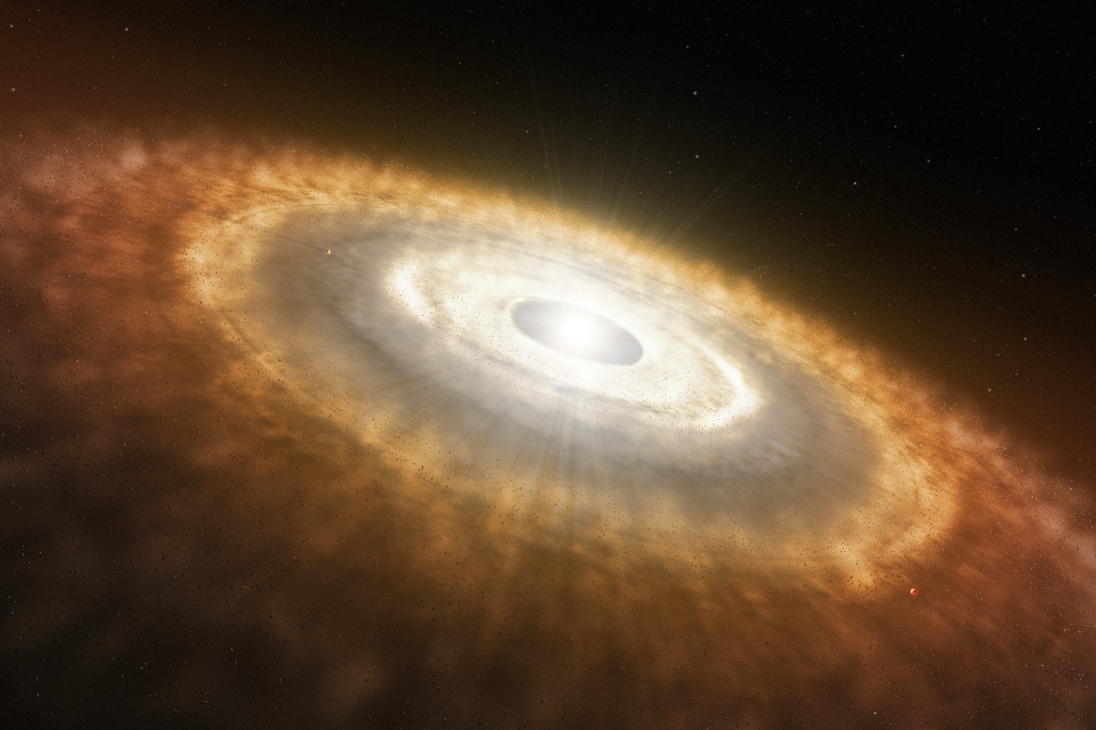
Dust Growth in Transitional Disks
Paola Pinilla
PhD student
Heidelberg University
ZAH/ITA
1st ITA-MPIA/Heidelberg-IPAG Colloquium
"Signs of planetary formation and evolution"
Oct 8/ 2012

Slide 2
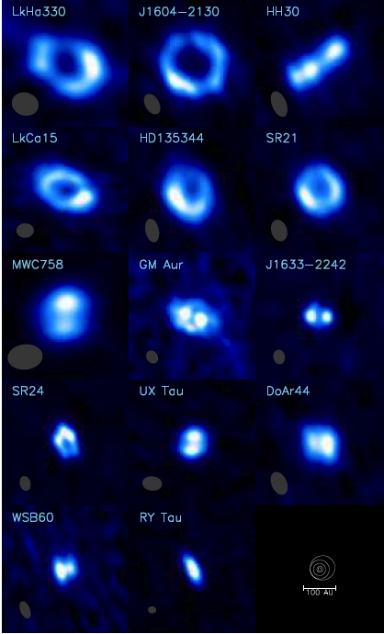
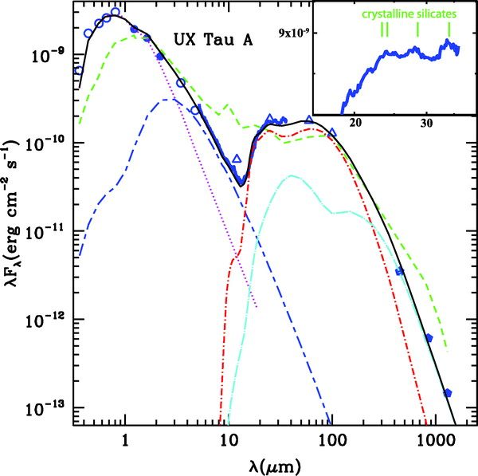
Transitional Disks (TD)
Lack of near-IR excess: inner disk clearing.
Different SED morphologies.
Sub-millimeter interferometry confirms the inner holes (~4-50AU)
20% of the disk population
Espaillat et al. (2007)
Williams & Cieza (2011)

Slide 3
Potential Origins of TD
Viscous Evolution
Photoevaporation
Particle Growth
Interaction with planets/companions
NOT ALONE (Birnstiel et al 2012)
How is the dust growth in a disk, where the gas density profile is determined by its interaction with a massive planet?

Slide 4
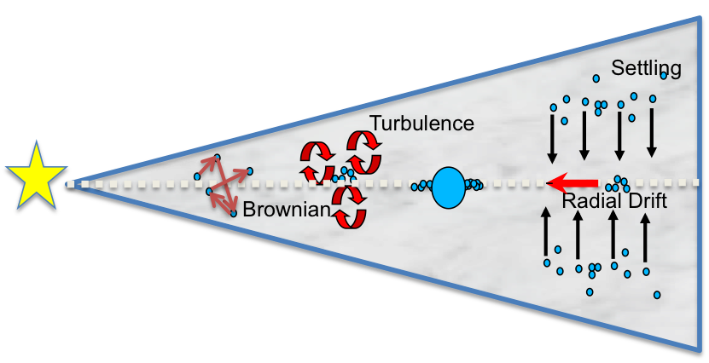
Dust Growth
Dust particles grow, fragment and crater
due to radial drift, turbulent mixing
and gas drag.
Brauer et al. (2008)
Birnstel et al. (2010a)
Fragmentation velocities based on laboratory
experiments and numerical simulations with silicates and ices.
Blum & Wurm (2008)
Wada et al. (2009, 2011)

Slide 5
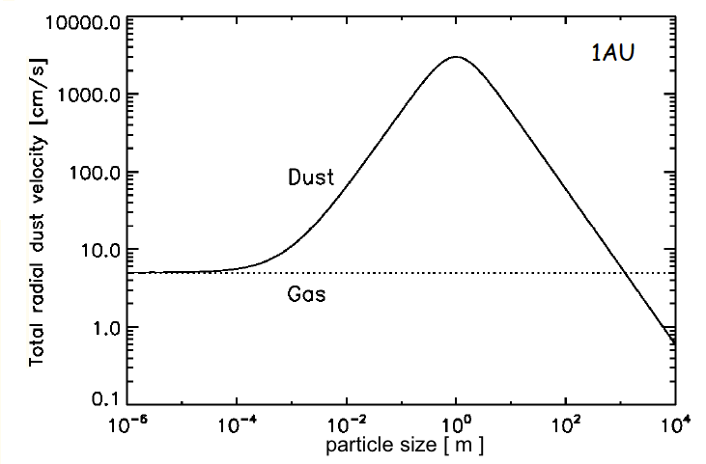
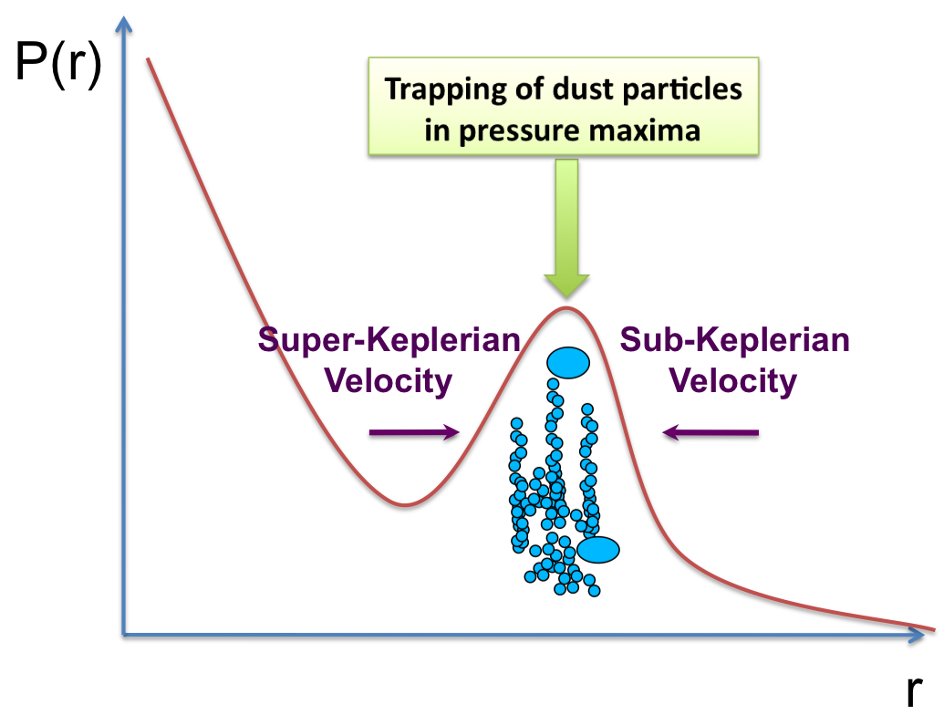
Why TD can be ideal for dust growth?
Meter-size Problem
Solution: Particle Traps
Weidenschilling (1977), Brauer et al (2008)
e.g. Klahr & Henning (1997) ; Fromang & Nelson (2005); Johansen et al. (2009); Pinilla et al. (2012a)
Dust particles fragment and drift
towards the star in timescales of 100
years before any meter-size object can
be formed.
Possible Pressure Bump:
Presence of a massive planet

Slide 6
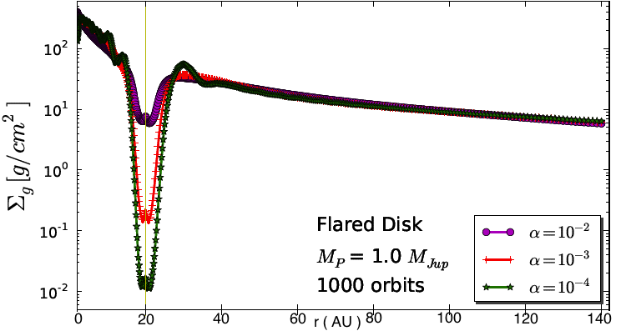
Planet-Disk Interactions
Disk Temperature (scale height)
Disk Mass
Viscosity
Planet Mass
5 r_{H}
Gas gap radius
Pinilla et al. (2012b)
Do we need multiple planets
for the observed wide gaps in TD?
Dodson-Robinson & Salyak (2011)
Zhu et al. (2011, 2012)

Slide 7
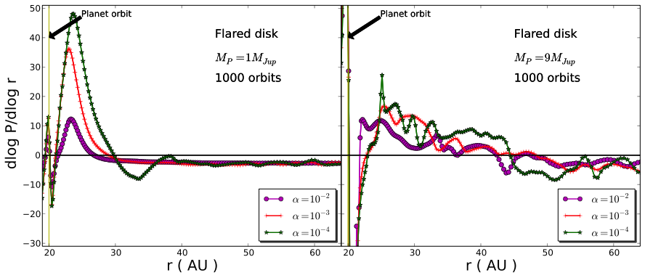
Pressure Gradient
Case of 1 M_{Jup}
Case of 9 M_{Jup}
Pinilla et al. (2012b)

Slide 8
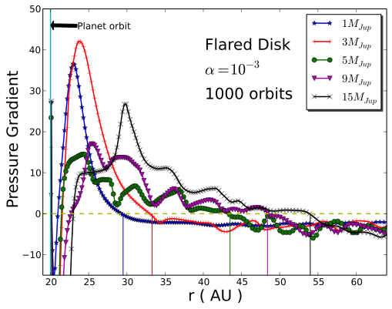
Gas vs Dust Gap
GAS (5 Hills radius)
DUST
    NO Eccentricity
    For M_{planet} ≤ 3 M_{Jup}
    Kley, W. & Dirksen, G. (2006)
    Eccentric Disk
    For M_{planet}>3 M_{Jup}
Pinilla et al. (2012b)
Ring of millimeter particles would be located at distances that can be more than twice the star-planet separation

Slide 9
Combination of gas and dust evolution
Methodology
2D hydrodynamical simulations of a massive planet embedded in a disk (Using FARGO, Masset 2000)
Gap opening process reaches a quasi-steady state (≤ 1000 orbits ≈ 10⁻² Myr)
Input for dust density evolution (until several Myr): stationary gas density carved by a massive planet

Slide 10
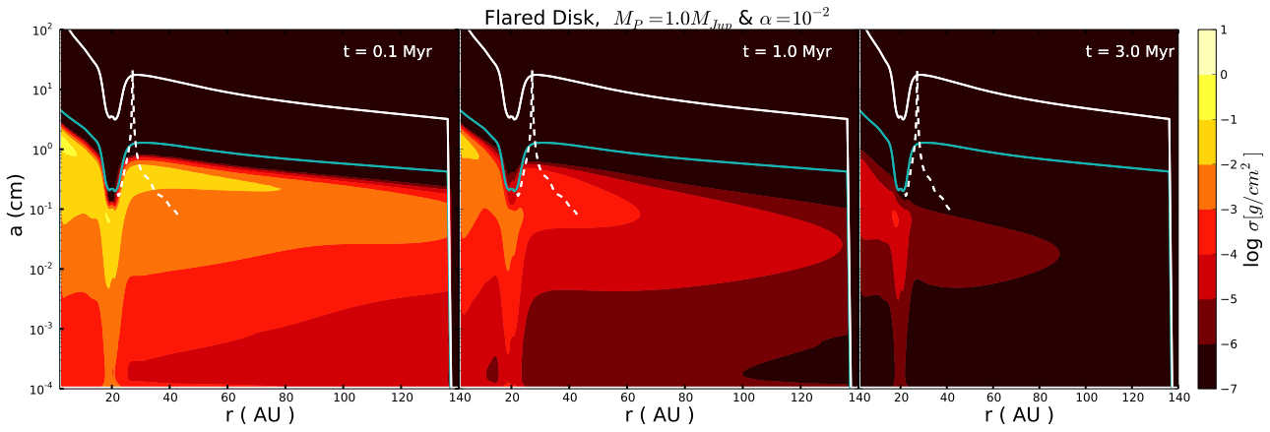
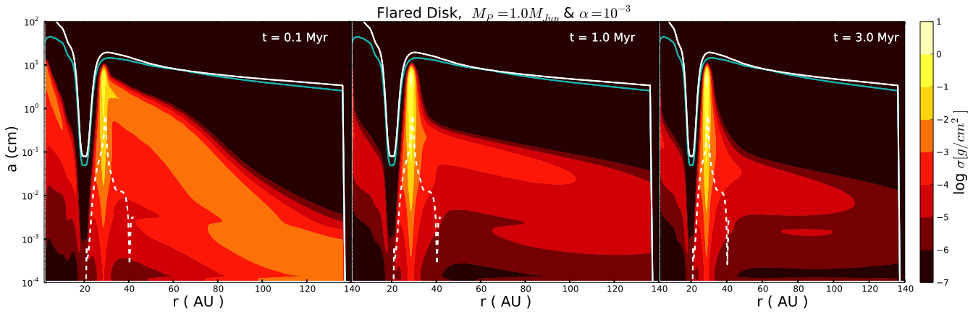
Turbulence Effect
1 M_{Jup}
Pinilla et al. (2012b)

Slide 11
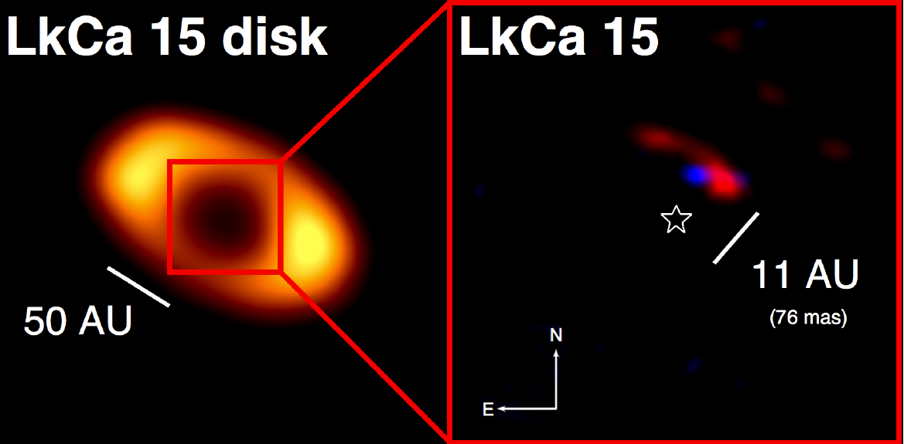
The case of LkCa15
Kraus & Ireland (2011)
Planet at 15.7± 2.1 AU with mass of 6 M_{Jup} to 15 M_{Jup}

Slide 12
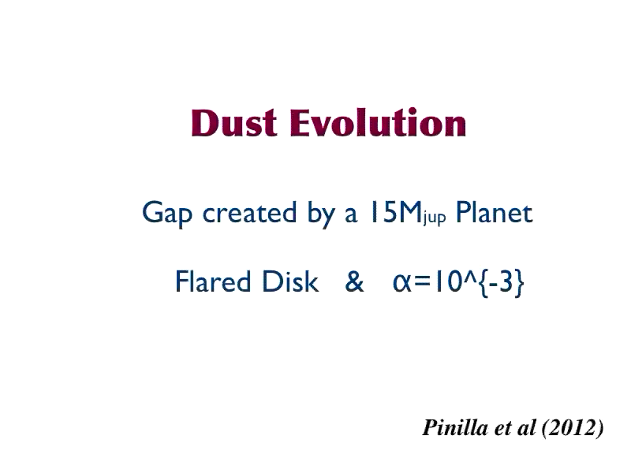
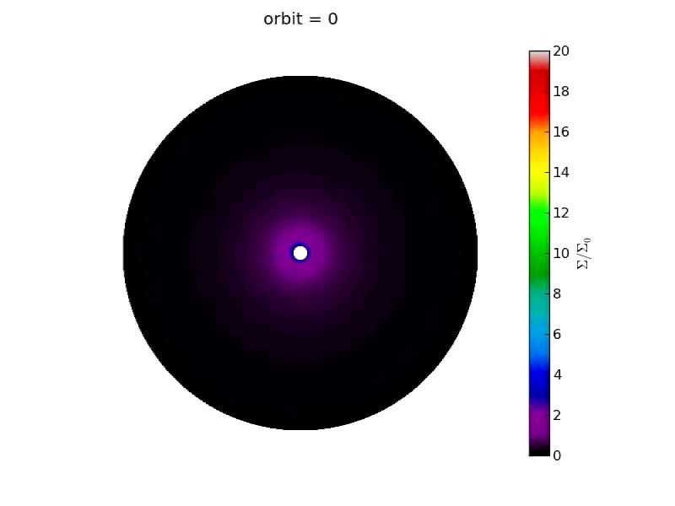
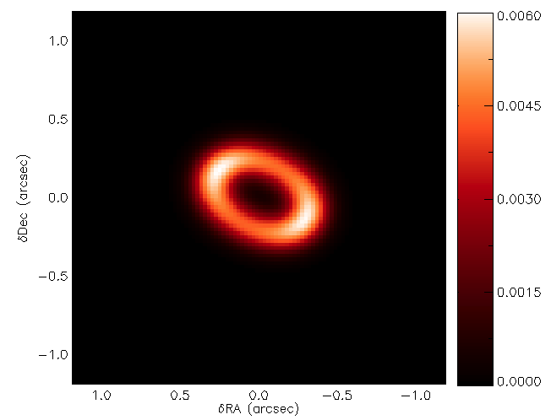
Ring shaped sub-mm emission
Gaps formed by massive planets
Dust Evolution
FARGO simulation with a
15 M_{Jup} planet embedded in a disk
1.3mm continuum model map convolved with a beam 0.21’’x0.19’’ (Isella et al 2012). Units in Jy/beam

Slide 13
Conclusions
The combination of 2D-hydrodynamical simulations and dust evolution modeling creates a large spatial separation between the gas inner edge of the outer disk and the peak millimeter emission.
Single massive planet can explain the observed wide holes of transitional disks.
Measuring the spectral index of transitional disks with ALMA will help to test the idea that the ring structures are indeed particle traps.

Slide 14
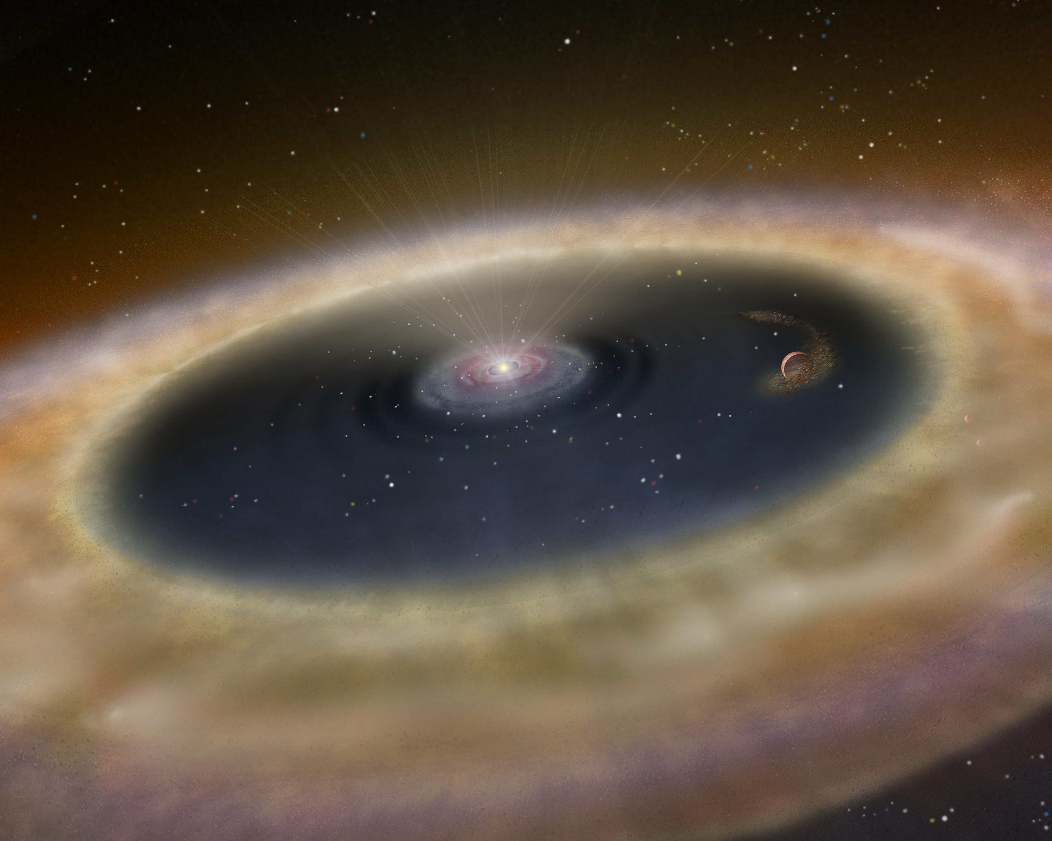
Thank you for your attention

Slide 15
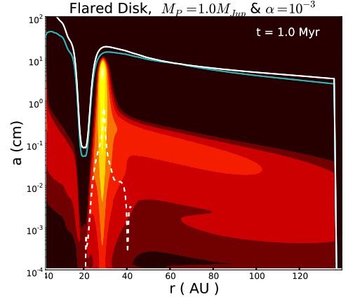
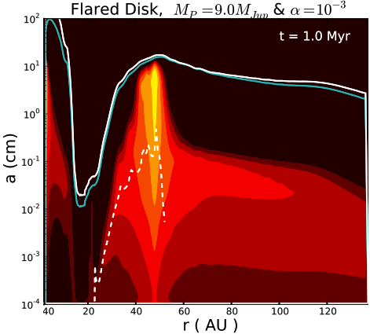
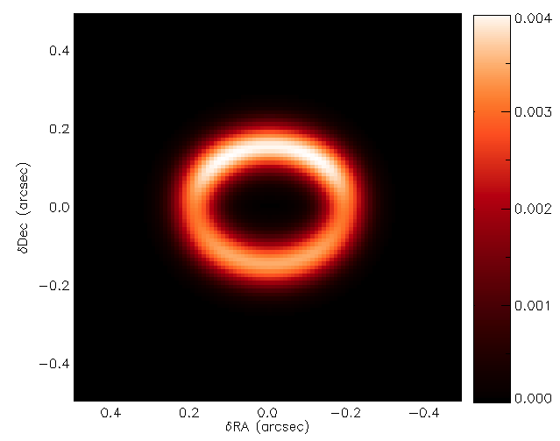
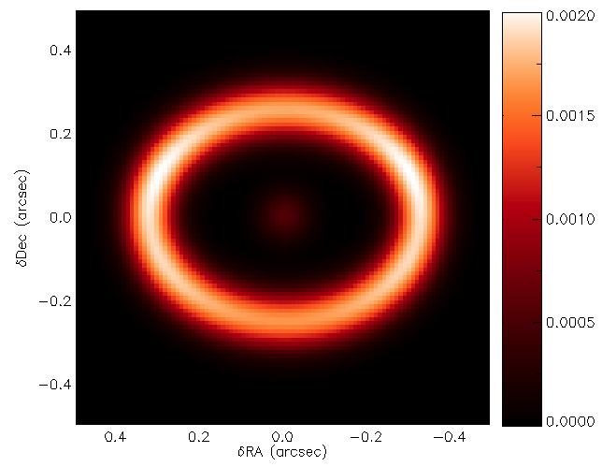
Model Images at 1.3mm
Units in Jy/beam

Slide 16
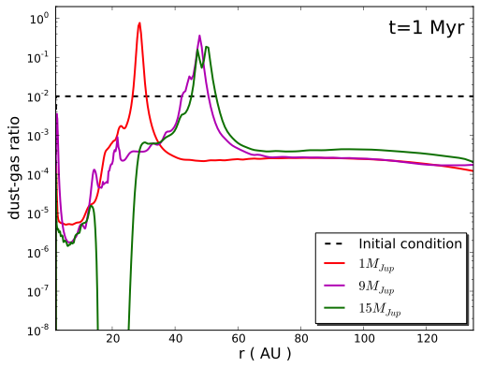
Dust Filtration
For 1 and M_{Jup,} there is still some dust going through the gap and replenishing the inner disk.
For 15M_{Jup}, all the dust is filtered: Empty cavity

