Slide 1
Kozai migration with tidal friction Application to GJ 436 (Beust et al., 2012, A&A 545, A88)
Hervé Beust
Institut de Planétologie et d’Astrophysique de Grenoble
FOST team

Slide 2
Gliese 436 b
A hot Neptune orbiting a M dwarf
Semi-major axis a = 0.0287 AU, e = 0.15, P = 2.644 days
Aged ~ a few Gyrs
Should have been tidally circularized a long time ago

Slide 3
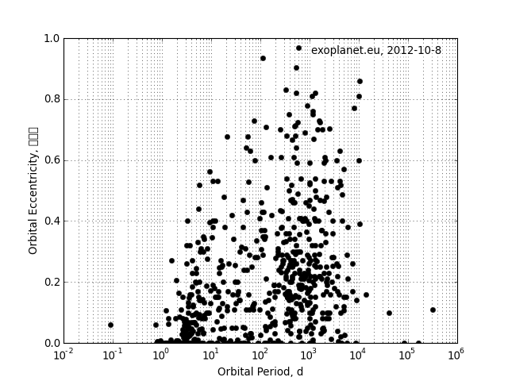
Period / eccentricity diagram for exoplanets
Exceptions
Tidally circularized

Slide 4
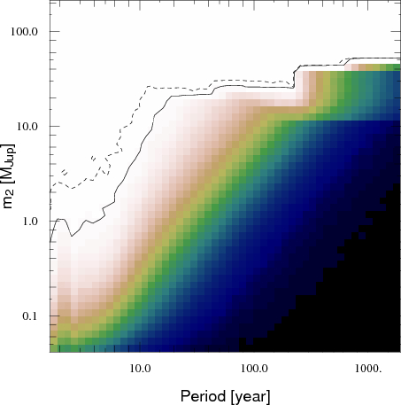
How can we explain the residual eccentricity ?
Low tides (Q_{p} ≳ 10⁶) ⟹ long circularization time (Mardling 2008); but for Neptune Q_{p} ≈ 10⁵. A very different planet ?
Planetary perturbations to sustain eccentricity ? Not easy
There are residuals in radial velocity signal ⟹ distant perturber? (Manness 2007)
Best constraints today, based on residuals and photometry (Montagnier, in prep) : upper limits
Resonant or non resonant planets hardly do the job : tides are always stronger
Batygin (2009) : Very specific stationary eccentricity configuration ⟹ longer circularization time

Slide 5
Another idea : Kozai resonance
Kozai resonance in the 3 body system = secular large amplitude (0 – 0.9 or more) eccentricity and inclination modulation of an orbit perturbed by an outer inclined perturber (i_{rel}≳ 40°).
Time-scale ~ (P_{out}²/P_{in}) × (M_{total}/M_{perturber})
Could it account for GJ 436b’s eccentricity ? Needs to be tested …

Slide 6
Just try it…
Take GJ 436 b with its present orbit, and add a perturber compatible with Montagnier et al. constraints : 0.1 M_{J} @ 3.6 AU, but with mutual inclination = 75°
Integrate the system taking into account tides (assuming a standard Q_{p}=10⁵ value) and General Relativity (GR).
We use symplectic integration with averaged tides .

Slide 7
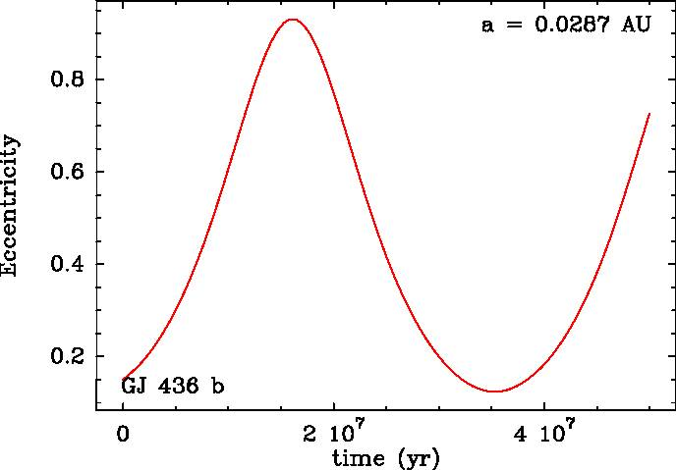
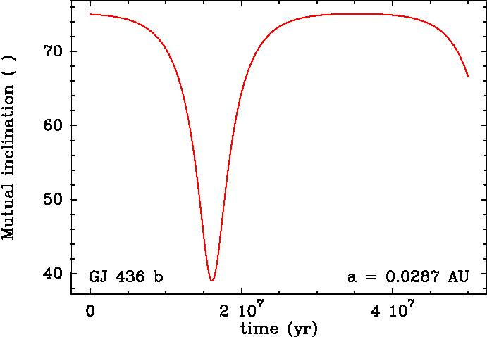
… and see what occurs
If we forget tides and relativity : Kozai !

Slide 8
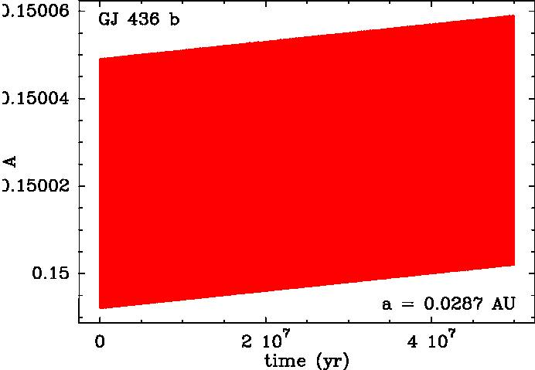
… and see what occurs
Now take relativity into account : No more Kozai !
Explanation : the GR periastron precession rate overcomes that of Kozai

Slide 9
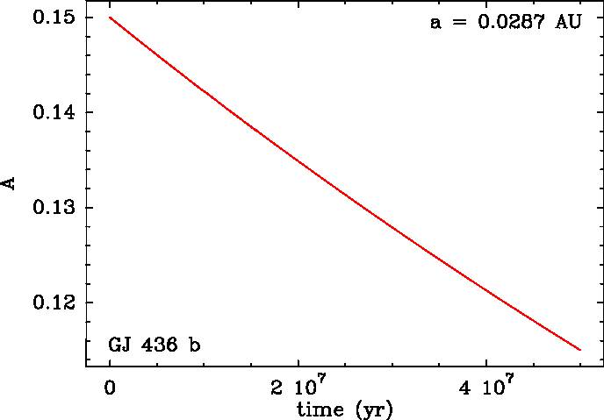
… and see what occurs
And now with tides and relativity : circularization !
Conclusion : Nothing changed. Tides are stronger than everything else…

Slide 10
Alternative scenario : Kozai migration
Idea : GJ 436b was formerly further away from the star (~10 times)
Kozai resonance is efficent : eccentricity increases periodically
At periastron, tides are active in high eccentricity phases ⟹ Slow orbital decay
⟹ Present day location with residual eccentricity ? Perhaps, needs to be tested

Slide 11
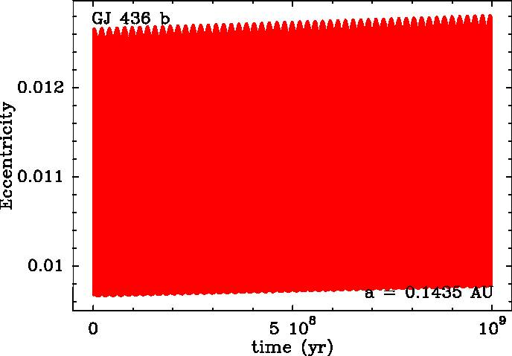
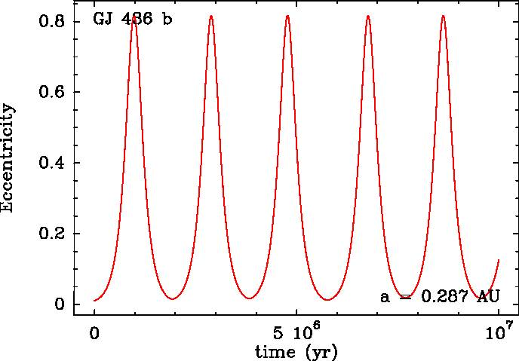
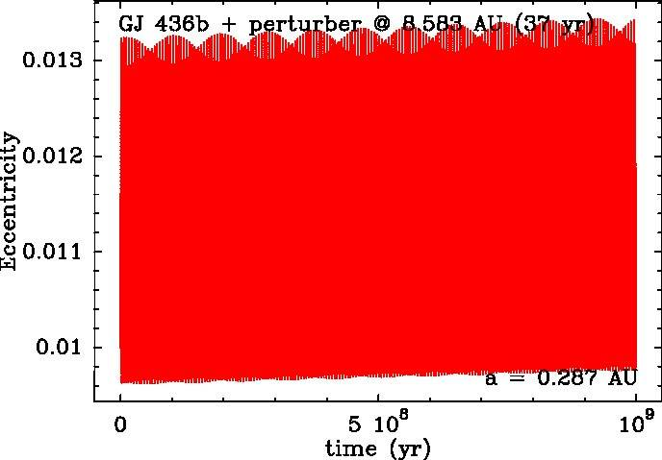
Let us try it !
Put GJ 436 b 10 times further away than today. Result : Kozai !
But don’t put the perturber too far away or GJ436b too close, otherwize no more Kozai…

Slide 12
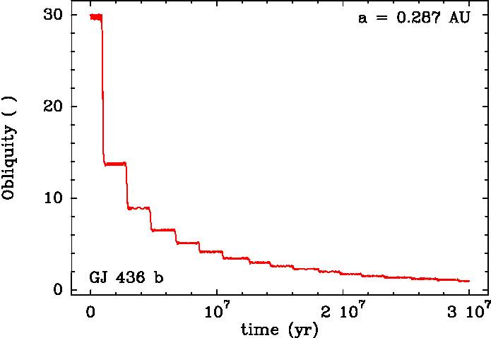
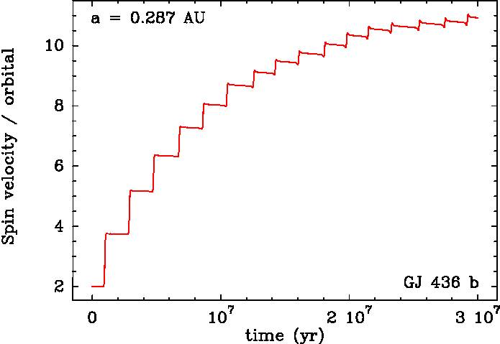
See what occurs in more details…
Spin axis is quickly aligned and synchronized with angular velocity at periastron
The planet gets accelerated !

Slide 13
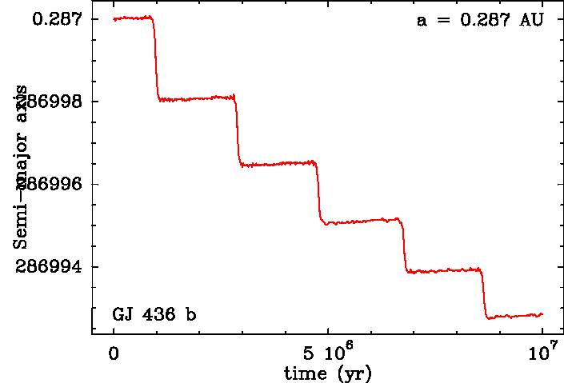
Orbital decay ?
Yes, when the eccentricity is high…

Slide 14
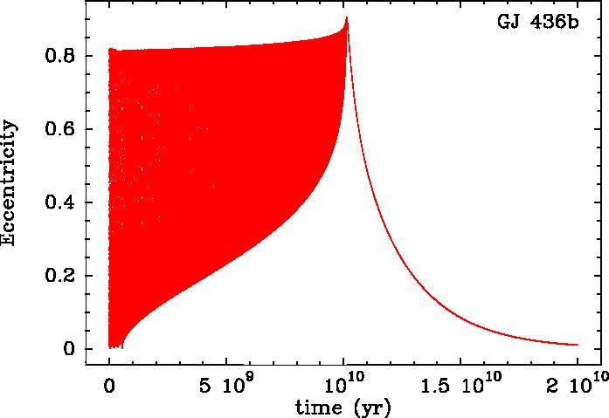
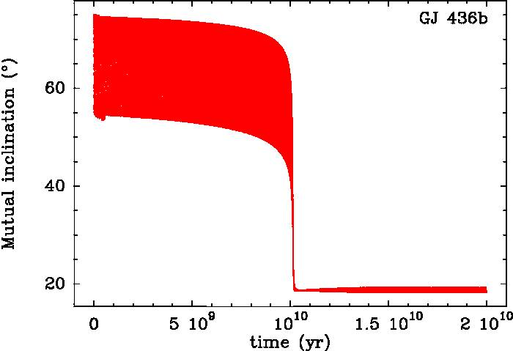
On a longer timescale…
Two-fold evolution: Kozai cycles keep working several Gyrs, and finally stop. Afterwards, a slow circularization starts.
A mechanism identified by Fabrycky & Tremaine (2007)

Slide 15
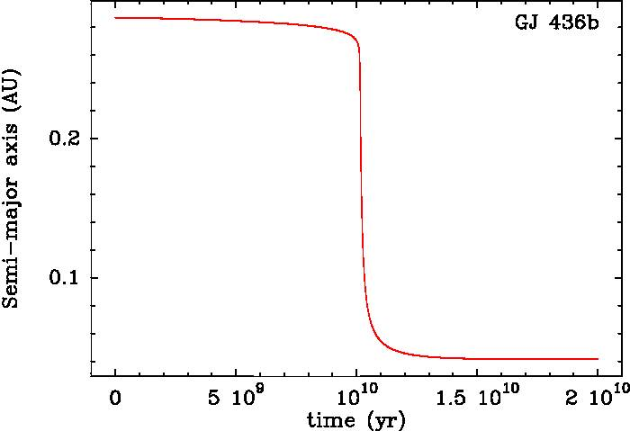
On a longer timescale (II)…
When Kozai is finished, the orbits decays more efficiently, but it takes time !
Explanation : at t_{tr}, we get out of Kozai resonance. We come to a stationary point in eccentricity. We start a slow circularization similar to that described by Batygin et al. (2009).
We could be in this decay phase today, on the way towards circularization, but with an already reduced semi-major axis
The important parameter is the transition time t_{tr} between the two phases

Slide 16
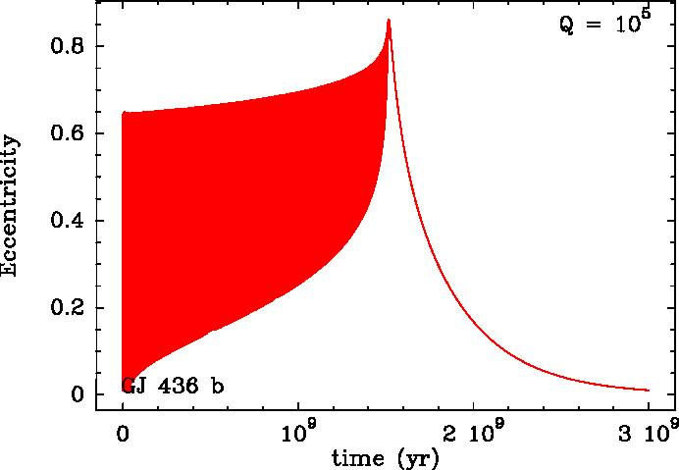
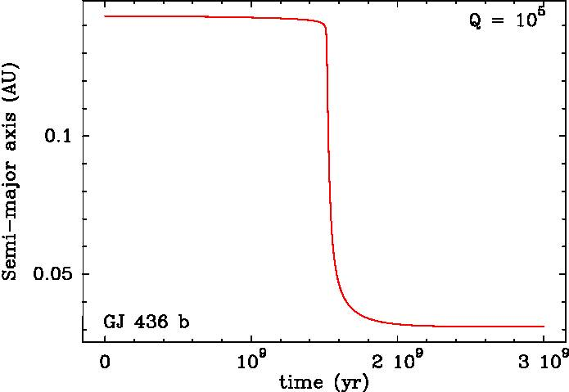
Let the parameters vary…
If we change the parameters, t_{tr} can vary considerably
Requirement : 1 Gyr ≲ t_{tr} ≲ 10 Gyrs
Massive or close-in perturber : fast Kozai ⇒ short t_{tr}
Small or distant perturber : slow Kozai ⇒ long t_{tr}

Slide 17
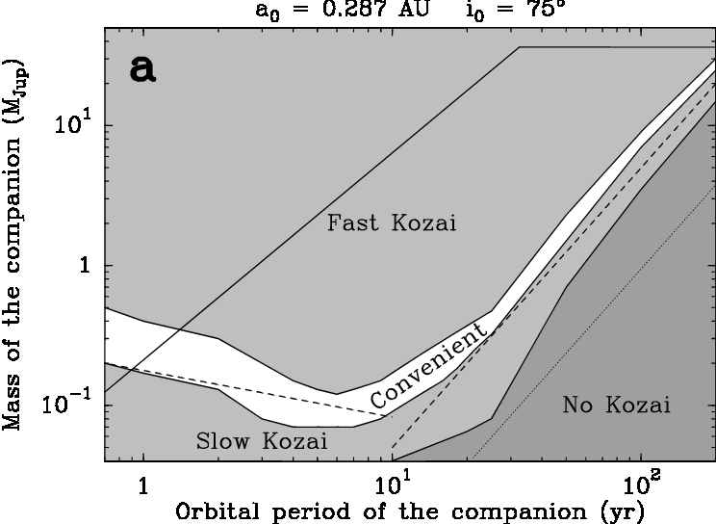
A parametric study
For a given initial semi-major axis and mutual inclination, we have a convenient strip in (P’,m’) plane. Two regimes
m ∝ P² : t_{tr}∝ t_{Kozai}
m ∝ P^{-1/3} : limitation by angular momentum ratio

Slide 18
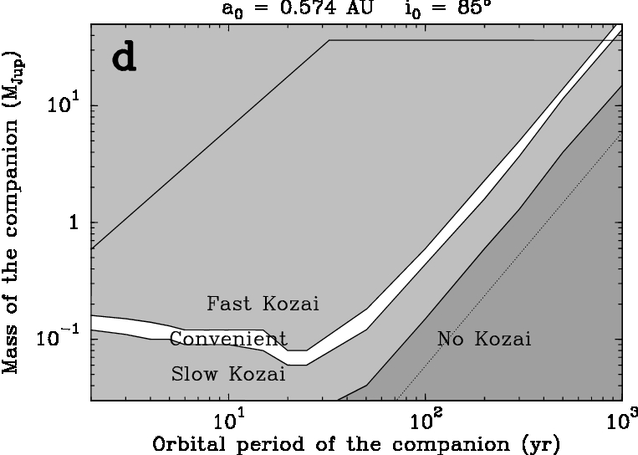
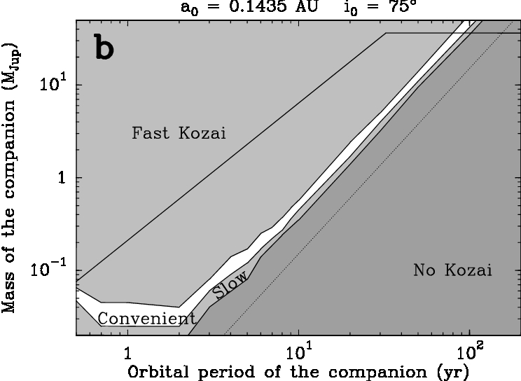
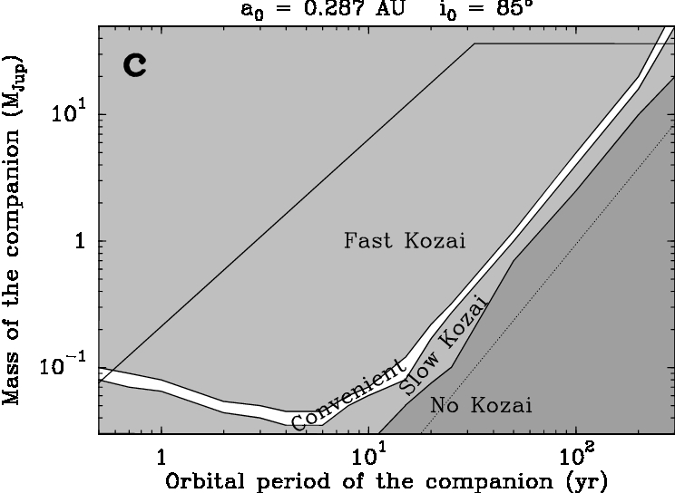
A parametric study (II)
We can change the (a₀,i₀) sets..
Result : 70° ≲ i₀ ≲ 110°
0.1 AU ≲ a₀ ≲ 10 AU

Slide 19
Conclusion
The Kozai migration process is characterized by two phases
It can solve the high eccentricity paradox of GJ 436b
Best combination : Perturber ~ 0.1M_{J}, P’~7 yrs, GJ436b initially ~10 times more distant, but a large variety of configurations are possible.
In any case, 70° ≲ i₀ ≲ 110° and 0.1 AU ≲ a₀ ≲ 10 AU
Needs to further monitor GJ436’s radial velocity to look for the companion
Could apply to other systems

