Slide 1
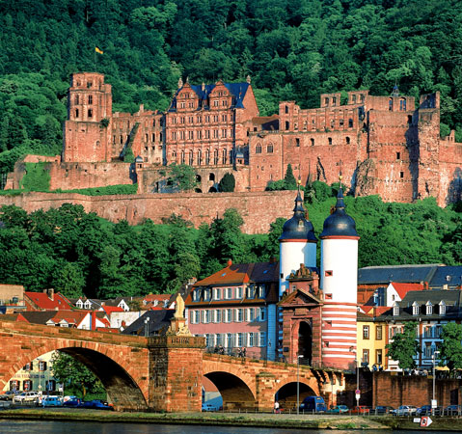
Astronomy in Heidelberg

Slide 2
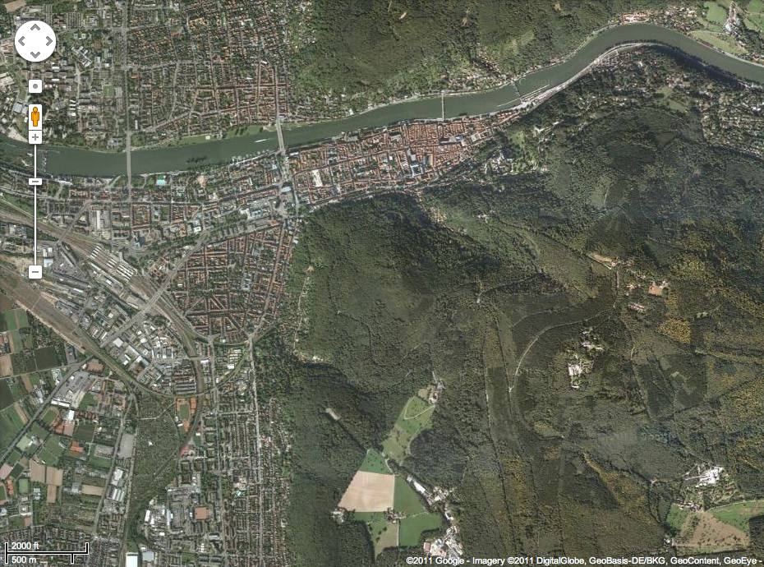
Astronomy in Heidelberg
ZAH-ARI
HITS
ZAH-ITA
Altstadt
ZAH-LSW
MPIA
HdA
MPIK

Slide 3
Astronomy at Heidelberg University
ZAH-ARI
HITS
ZAH-ITA
Altstadt
ZAH-LSW
MPIA
HdA
MPIK

Slide 4
Astronomy at Heidelberg University
Center for Astronomy Heidelberg (ZAH)
Astronomical Calculational Institute (ARI)
Galactic Neighborhood (Group Grebel)
Gravitational Lensing (Group Wambsganß)
Cosmology (Group Schäfer)
Institute for Theoretical Astrophysics (ITA)
Cosmology (Group Bartelmann)
Star Formation (Group Klessen)
Planet Formation (Group Dullemond)
State Observatory (LSW)
Galactic Archeology (Group Christlieb)
Instrumentation (Group Quirrenbach)
Shown here:
Only groups of
full professors
There are in
total 23 groups
Heidelberg Institute for Theoretical Studies (HITS) Funded by the Tschirra Stiftung
Computational Astrophysics (Group Springel)

Slide 5
(Exo-)Planet(-Formation) at ZAH
(Exo-)Planet(-Formation) at ZAH
Astronomical Calculational Institute (ARI)
Exoplanets by microlensing (Group Wambsganß)
N-body Astrophysics (Group Spurzem)
Institute for Theoretical Astrophysics (ITA)
Planet formation (Group Dullemond)
Protoplanetary dust (Group Gail)
State Observatory (LSW)
CARMENES (Group Quirrenbach)

Slide 6
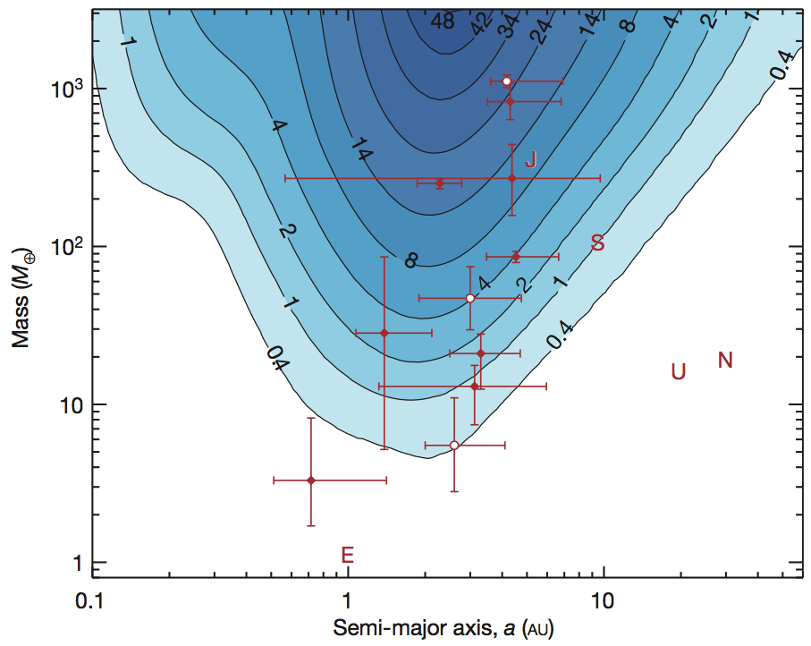
Example from Microlensing
(Group Wambsganß)
Conclusion:
There must be many
undetected low-mass
planets (Neptunes).
Quote:
„One or more bound planets per Milky Way star from microlensing observations“
Cassan et al. 2012, Nature

Slide 7
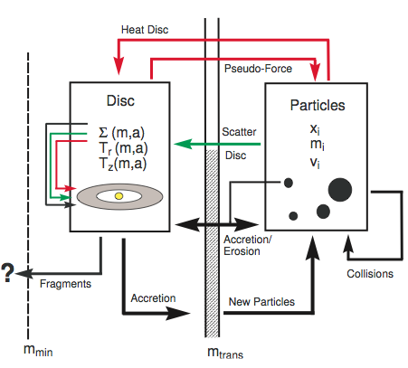
Example from N-body
(Group Spurzem)
A Hybrid method of planet
formation modeling:
- Many small particles =
statistical methods
- Few big particles =
N-body

Slide 8
Example from dust growth
(Group Dullemond)
How to break through
the meter-size barrier.
Low sticking efficiency
Particle abundance
Windmark, Birnstiel, Güttler, Blum, Dullemond, Henning 2012

Slide 9
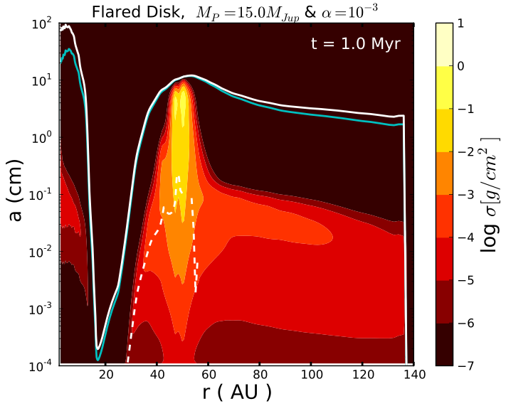
Example from dust growth
(Group Dullemond + Grenoble)
Comparing with
observations
Pinilla, Benisty & Birnstiel (2012)

Slide 10
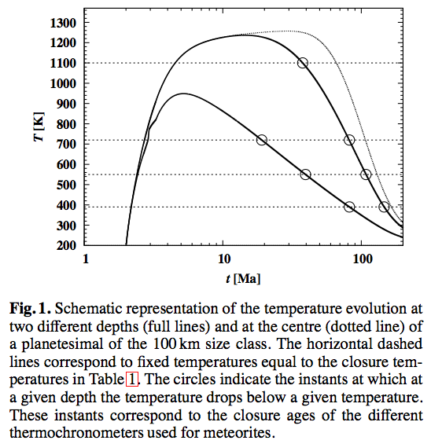
Example from asteroids
(Group Gail)
Henke, Gail, Trieloff,
Schwarz, Kleine (2012)

Slide 11
Example from RV planet detection
(Group Quirrenbach)

